Slide 1
WHAT IS MICROSERVICES

Slide 2


Slide 3


Slide 4


Slide 5
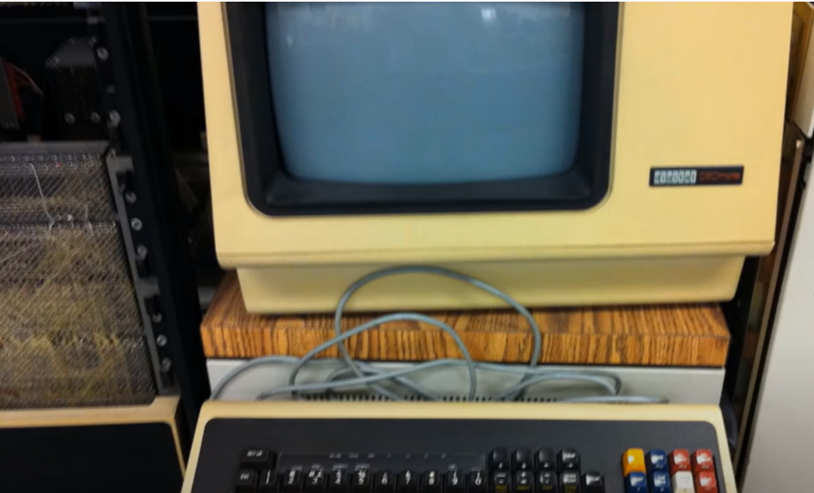

Slide 6
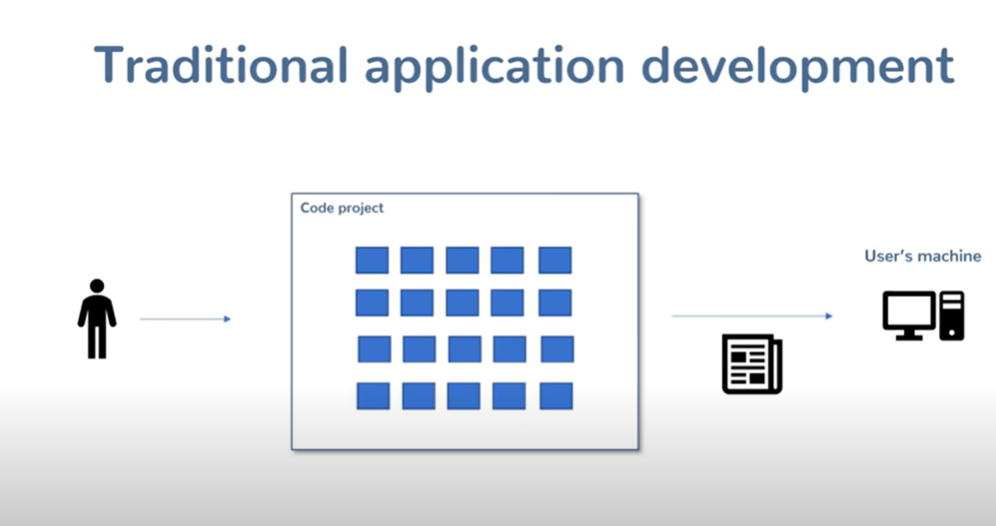

Slide 7
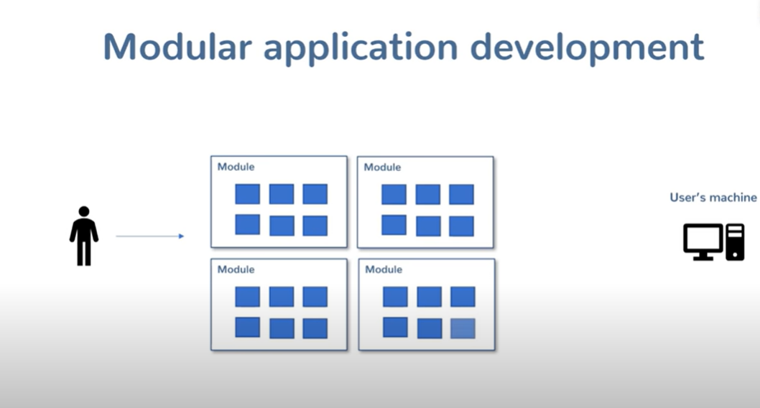

Slide 8
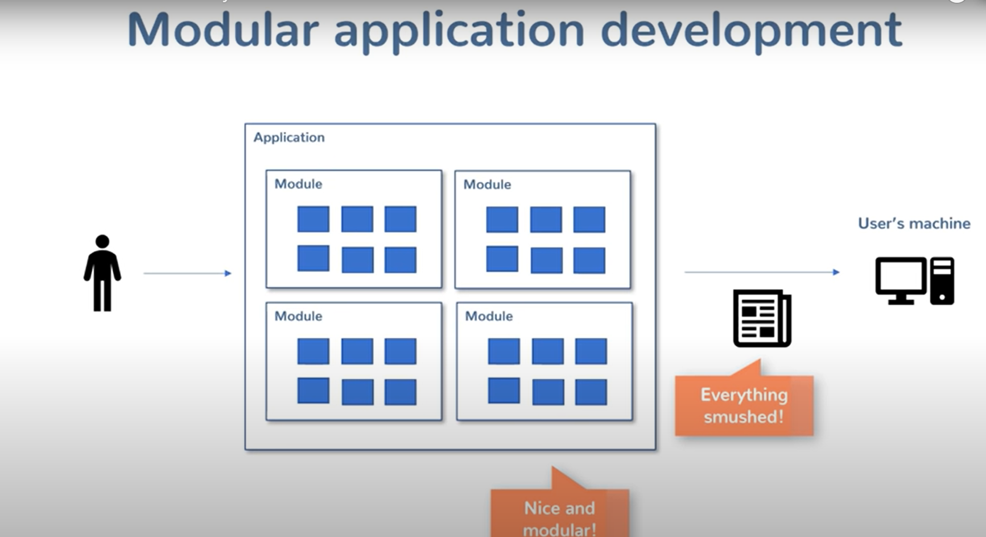

Slide 9
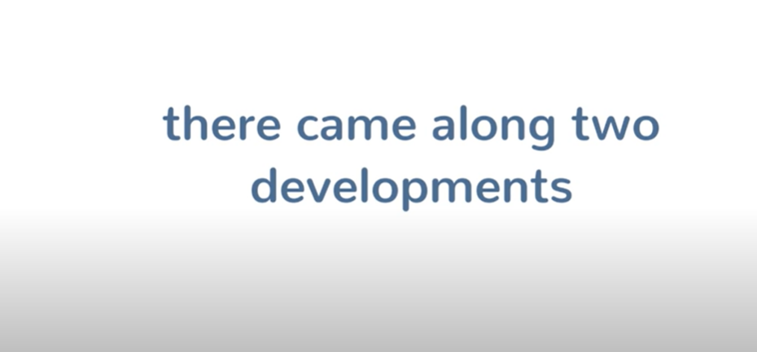

Slide 10


Slide 11
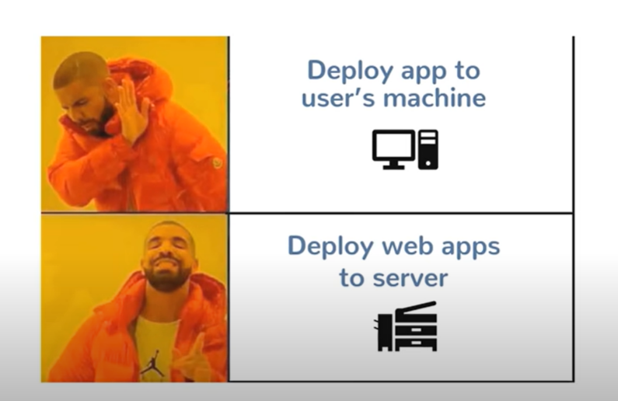

Slide 12
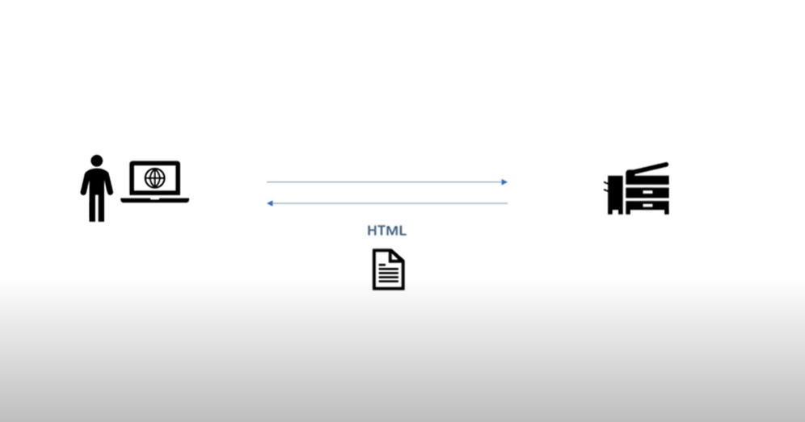

Slide 13
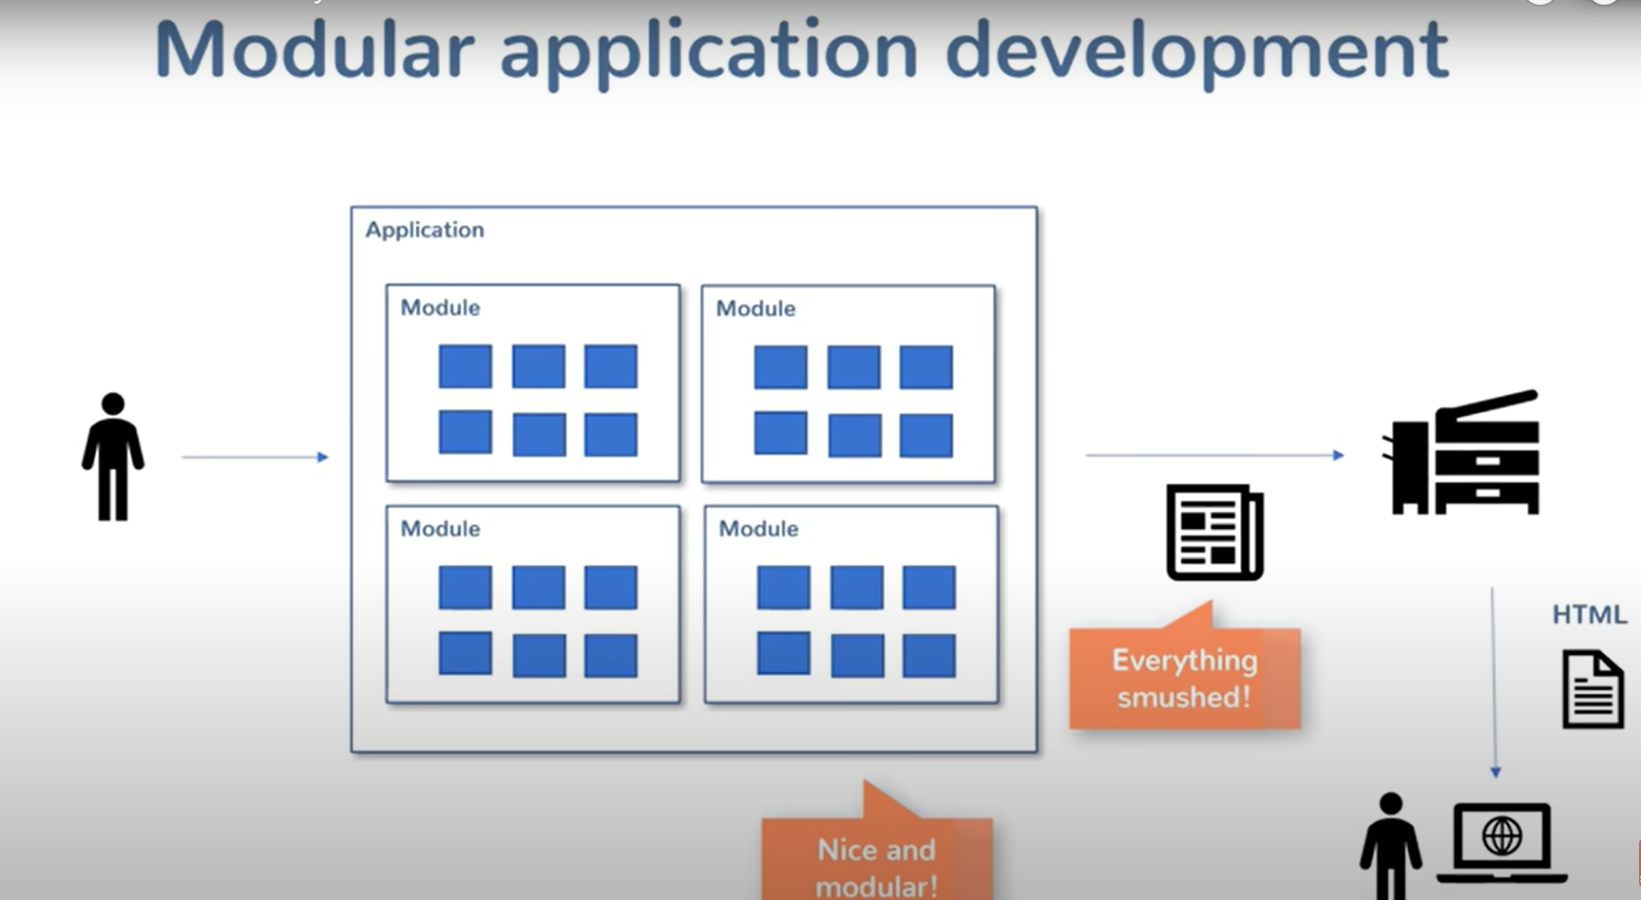

Slide 14
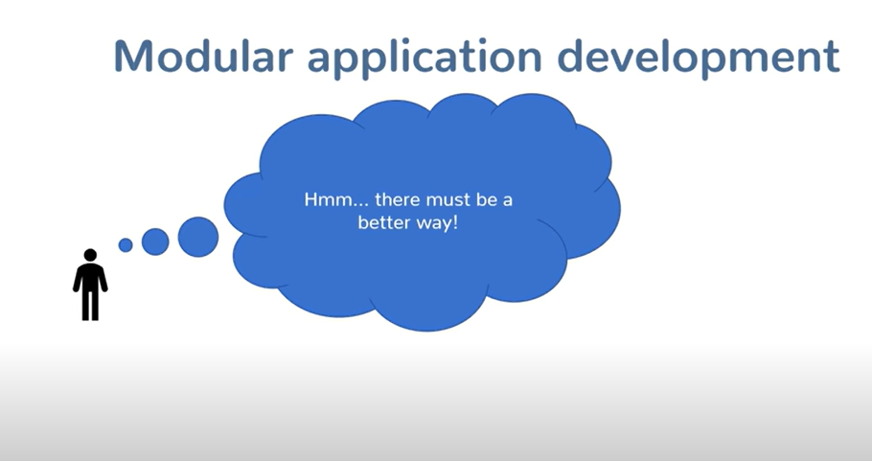

Slide 15
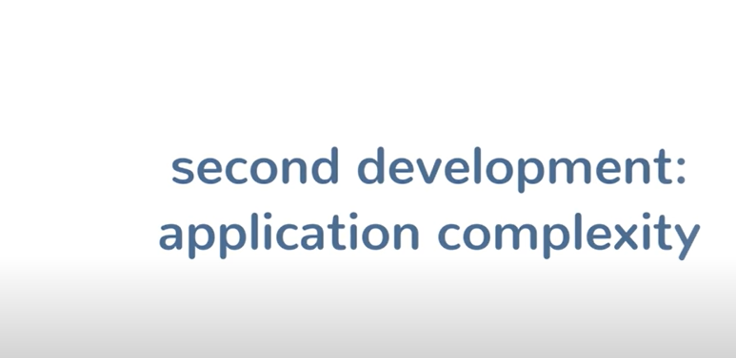

Slide 16


Slide 17
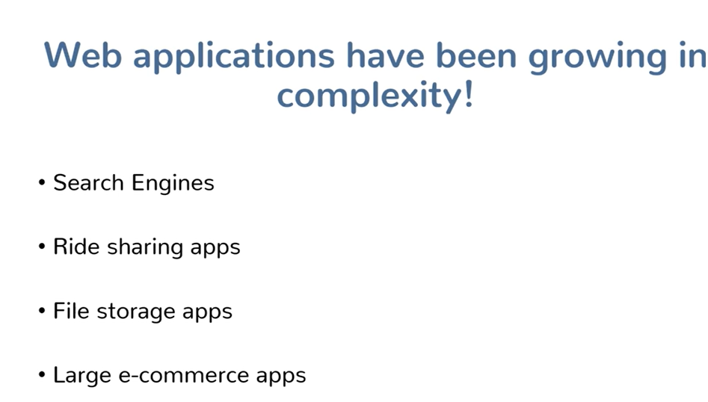

Slide 18


Slide 19
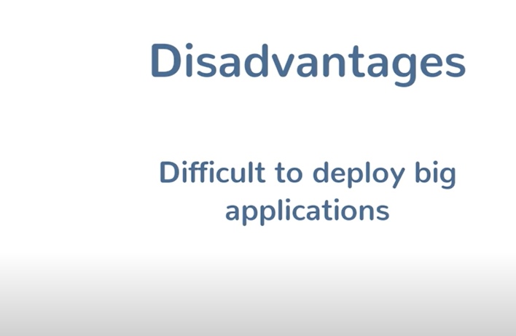

Slide 20
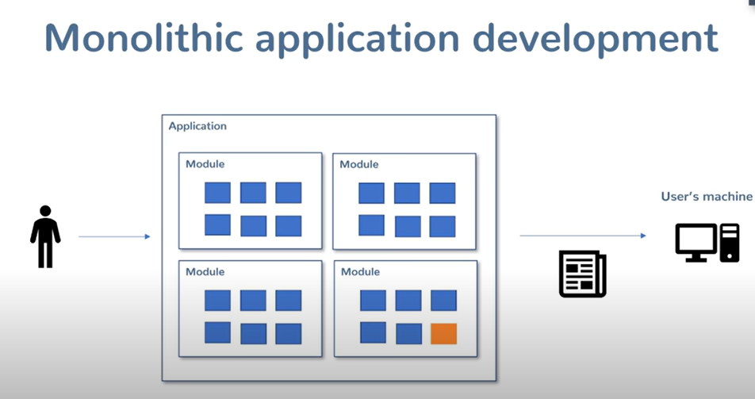

Slide 21
Can’t test whole application everything, even though there’s a probability of bugs

Slide 22
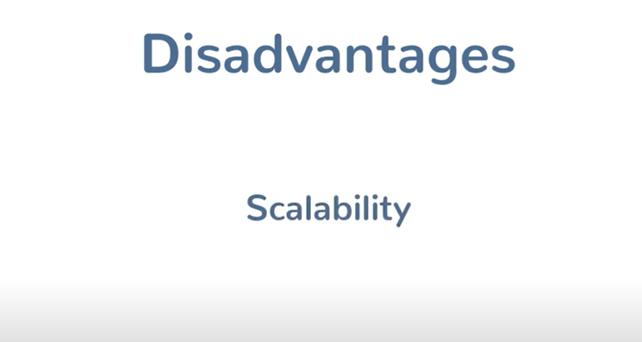

Slide 23
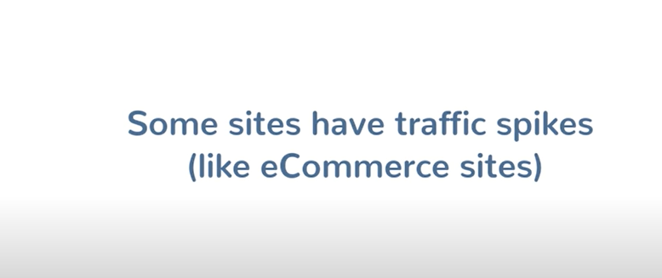

Slide 24
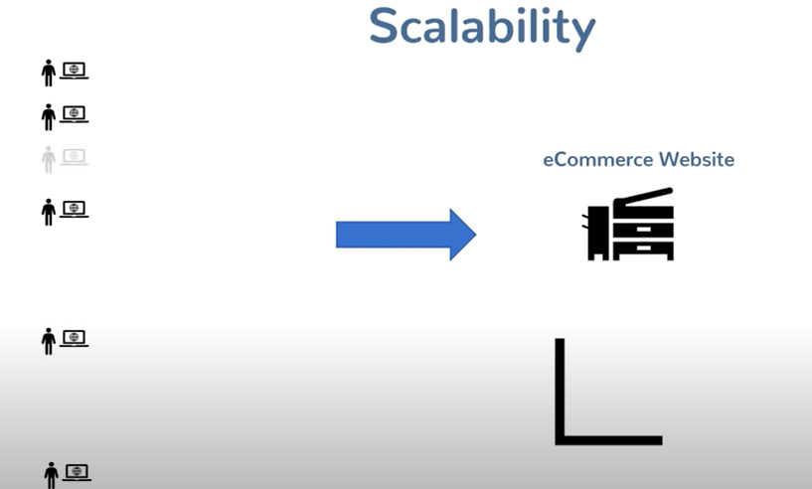

Slide 25
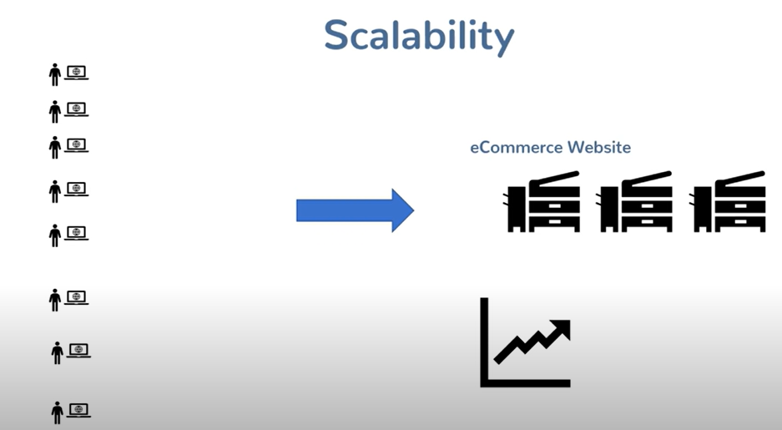
When traffic increases, number of instanceincreases, due to elastic

Slide 26
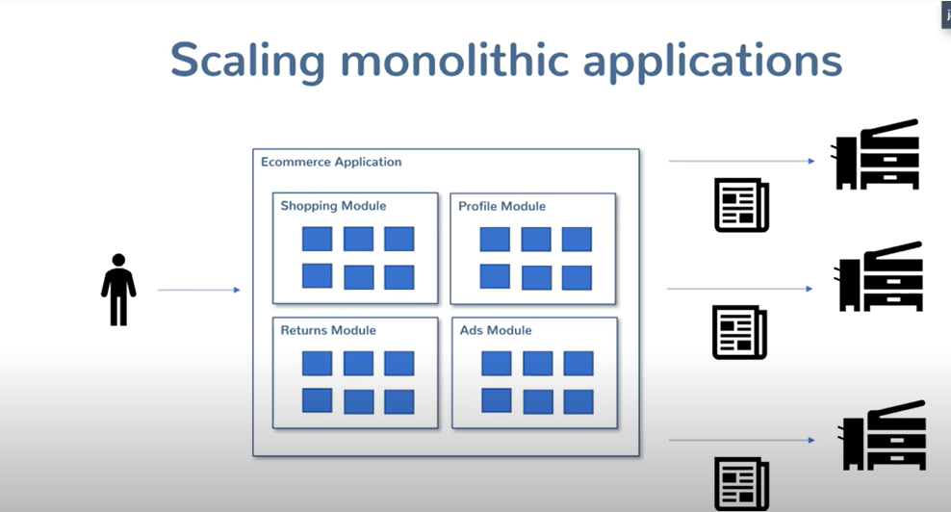
Eventhough spike is on one section, whole app must be scaled

Slide 27
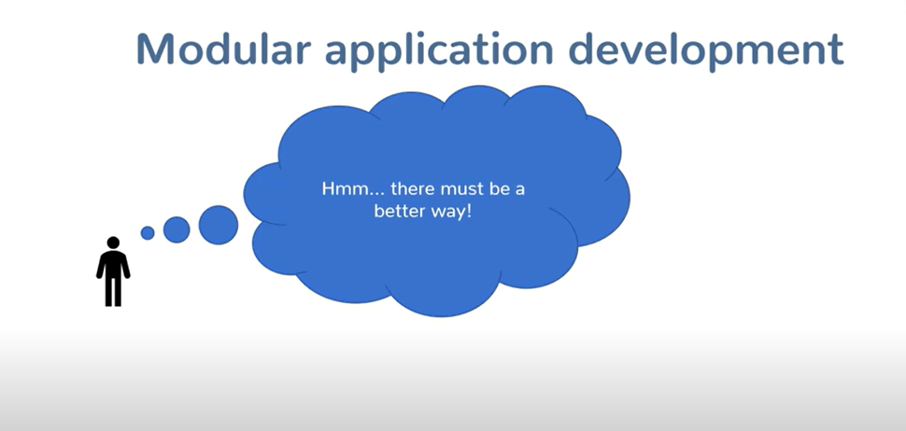

Slide 28
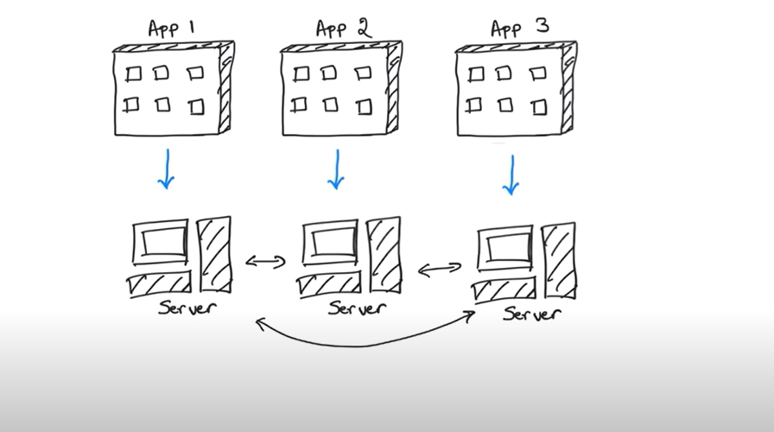
solution:

Slide 29
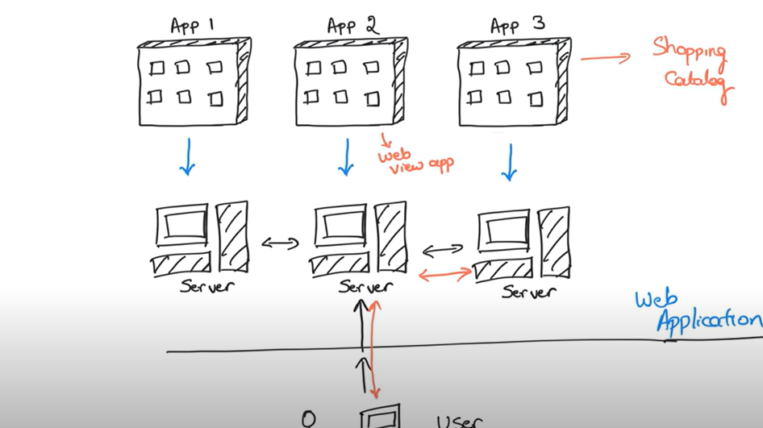

Slide 30
Testing
Scalability

Slide 31
Shopping catalogue - microservices

Slide 32
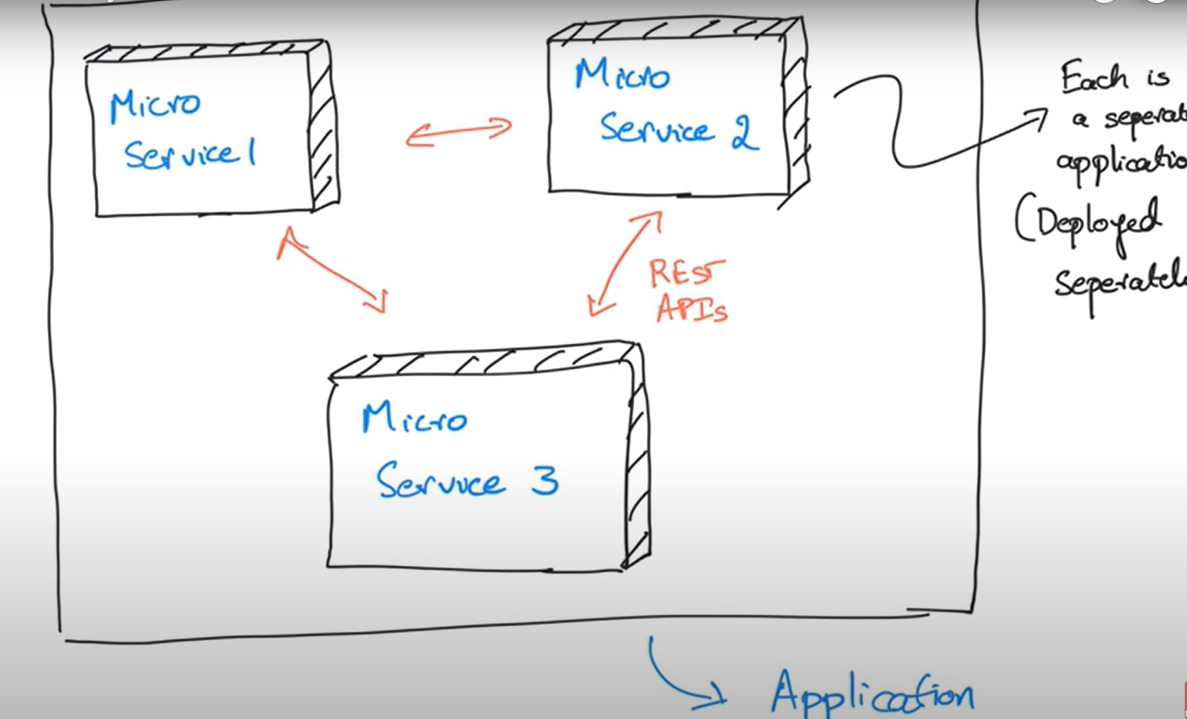

Slide 33
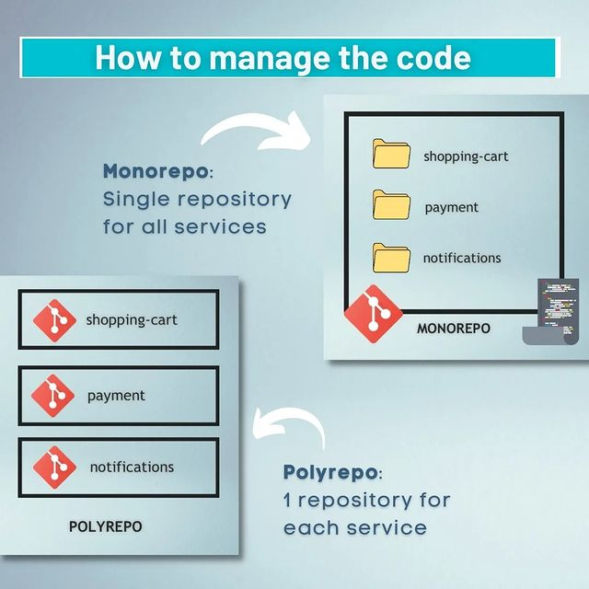

Slide 34
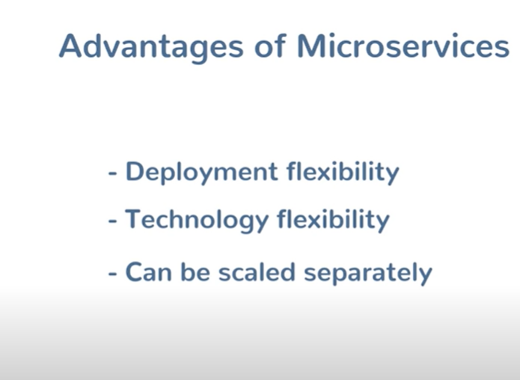

Slide 35
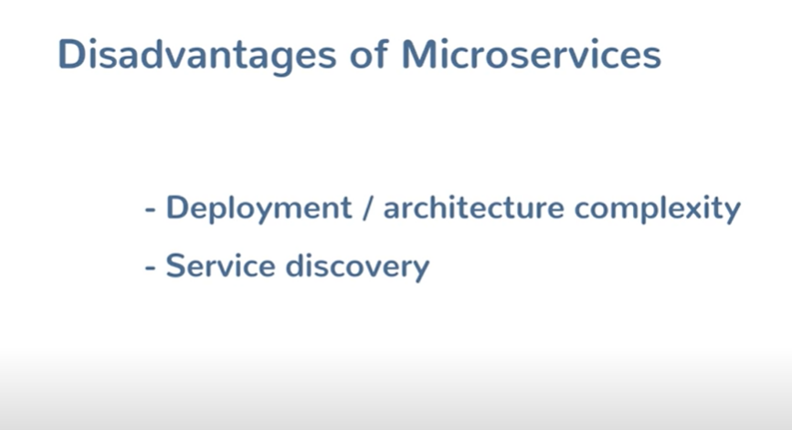

Slide 36
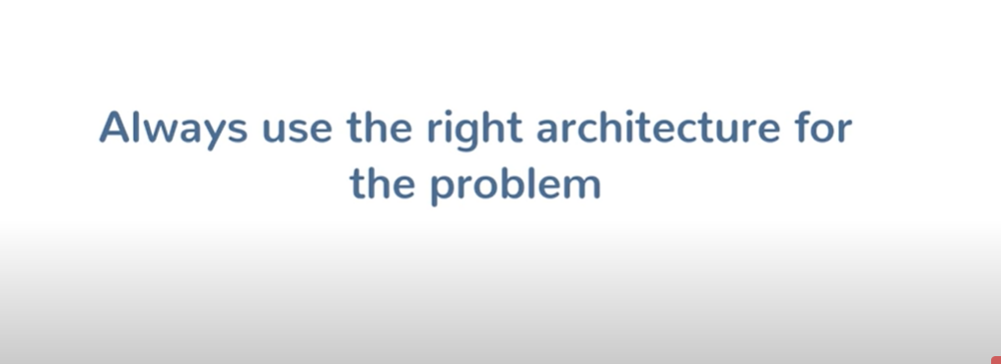

Slide 38
here are the following components of microservices:
Spring Cloud Config Server -> for external configuration
Netflix Eureka Naming Server -> discovery server
Hystrix Server -> fault tolerance
Netflix ZuulAPI Gateway Server-> gateway server, from where all client request pass through
Netflix Ribbon -> provides client side balancing algo
Zipkin Distributed Tracing Server -> send, receive, visualize traces

Slide 39
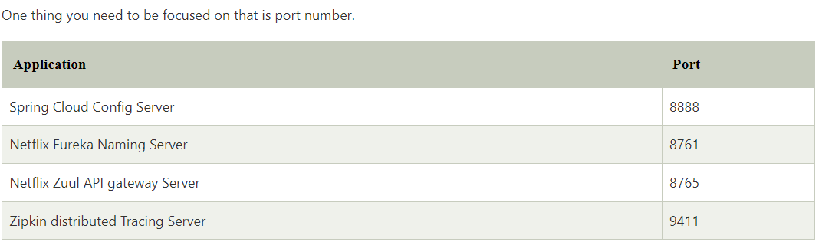

Slide 40
